Slide 1

NeuroFleetX: AI-Driven Urban Mobility Optimization
Infosys Springboard Internship 6.0
Student name: Bhanu Prasad Babu Bellala
Batch: 04

Slide 2

INTRODUCTION
The rapid expansion of urban centers presents unprecedented challenges for mobility. Congestion, pollution, and inefficient transportation networks demand innovative solutions. As cities grow, so does the complexity of managing large vehicle fleets, from logistics to public transport.
This scenario highlights a critical need for smart, real-time fleet intelligence that can adapt and optimize operations dynamically. Traditional methods are no longer sufficient to meet the demands of modern urban environments.
NeuroFleetX emerges as a comprehensive solution, leveraging cutting-edge AI to provide advanced optimization and enhance overall urban mobility systems.

Slide 3
PROBLEM STATEMENT
Lack of Real-time Visibility
Inefficient Booking & Dispatch
Absence of Predictive Maintenance
Fleet managers often don’t have live updates on vehicle location, health, or performance, leading to delays, confusion, and poor route decisions.
Manual or outdated booking and dispatch processes cause significant delays, increase operational costs, and reduce customer satisfaction.
Reactive maintenance leads to unexpected breakdowns, high repair costs, and prolonged vehicle downtime, impacting service delivery.
High Downtime & Low Utilization
Fragmented Fleet Management
Combined inefficiencies result in vehicles spending more time idle or in repair, significantly lowering asset utilization and profitability.
Many organizations rely on disparate systems that don't communicate, preventing a holistic view and integrated control of their entire fleet.

Slide 4










NeuroFleetX: Technology Stack
NeuroFleetX is built on a robust and scalable architecture, utilizing industry-standard technologies to ensure high performance, reliability, and ease of development. This modern tech stack enables rapid iteration and integration of advanced features.
Backend: Spring Boot
Frontend: React
Robust and scalable API services for seamless data handling and business logic.
Dynamic and responsive user interfaces for an intuitive user experience.
Database: MySQL
Reliable and efficient data storage for all fleet information and operational logs.
Version Control: GitHub
Collaborative development and comprehensive code management.
API Testing: Postman
Streamlined API development and testing to ensure system integrity.

Slide 5






Key Objectives: Driving Efficiency and Intelligence
Our primary goals for NeuroFleetX revolve around transforming fleet operations through intelligent automation and real-time insights, addressing the critical pain points identified in current systems.
Real-time Telemetry Tracking
Predictive Maintenance Alerts
Smart Vehicle Allocation
Implement live monitoring of vehicle location, speed, fuel levels, and engine diagnostics to provide a comprehensive operational overview.
Develop an system to anticipate potential mechanical failures, issuing timely alerts to minimize unexpected downtime.
Optimize vehicle assignments based on real-time demand, availability, and specific job requirements for maximum utilization.
Automated Booking Workflows
Admin Analytics Dashboard
Streamline the entire booking process from request to confirmation, reducing manual effort and improving response times.
Provide a centralized dashboard with actionable insights into fleet performance, operational efficiency, and key metrics.

Slide 6
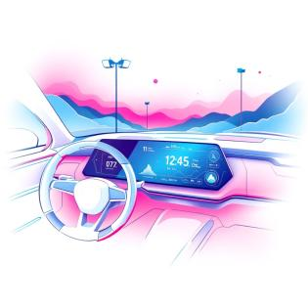

NeuroFleetX: Core Features for Comprehensive Management
NeuroFleetX is designed with a suite of features that provide end-to-end fleet management, from secure access to predictive analytics and operational automation.
Role-Based Authentication
Predictive Risk Scoring (0-100)
Ensures secure access and tailored functionalities for different user roles
(e.g., admin, customer, maintenance crew).
An engine assesses vehicle health and operational risks, providing a score to prioritize maintenance
and interventions.
Fleet Inventory Management
Booking & Dispatch Automation
A centralized system to track every asset, including vehicle details, registration, insurance,
and maintenance history.
Automated assignment of vehicles to requests, optimizing routes and schedules based on availability
and urgency.
Live Telemetry Monitoring
Real-time data streams for GPS location, fuel consumption, engine temperature, and
other vital parameters.
Admin Performance Reports
Detailed reports and visualizations on fleet utilization, fuel efficiency, maintenance costs,
and overall operational performance.

Slide 7
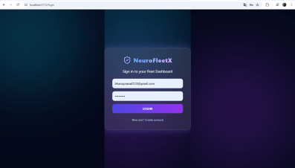
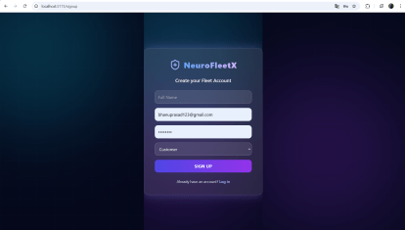
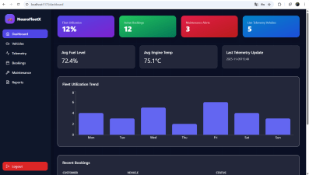
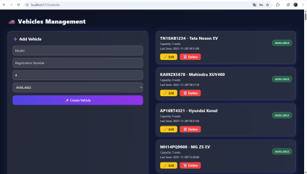

Slide 8
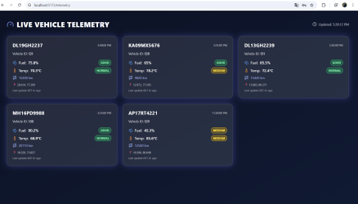
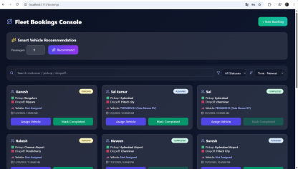
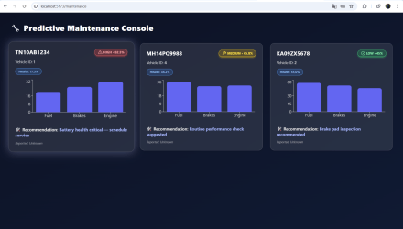
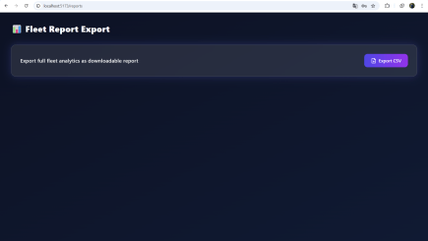

Slide 9

NeuroFleetX: System Architecture Overview
The NeuroFleetX architecture is designed for modularity, scalability, and seamless integration between its various components, ensuring a robust and efficient system.
User Interface
Booking & Dispatch
Task coordination
React frontend
Maintenance Engine
API Layer
NeuroFleetX
Service upkeep
Spring Boot services
Telemetry Engine
MySQL Database
Operational metrics
Persistent storage
This layered approach ensures that each component can be developed, tested, and scaled independently, providing a resilient and high-performing solution for fleet management.

Slide 10



Future Enhancements: Expanding NeuroFleetX Capabilities
NeuroFleetX is designed with future growth in mind. Our roadmap includes integrating advanced AI and IoT capabilities to further enhance optimization, safety, and operational efficiency.
AI-Driven Route Optimization
IoT Sensor Integration
Driver Behavior Analytics
Incorporating data from diverse sensors for richer telemetry and environmental monitoring.
Monitoring and analyzing driving patterns to promote safer habits and reduce operational risks.
Dynamic route planning to minimize travel time, fuel consumption, and environmental impact.
Centralized Mobile App
Automated Maintenance Scheduling
A unified mobile interface for drivers and administrators to access real-time data and manage tasks on the go.
Proactive scheduling of vehicle servicing based on predictive analytics and usage patterns.

Slide 11



CONCLUSION
NeuroFleetX is more than just a fleet management system; it's a vision for the future of urban mobility. By integrating advanced real-time data, it delivers a complete, intelligent solution.
Enhanced Fleet Performance
Reduced Operational Costs
Optimizing every aspect of fleet operations, from dispatch to maintenance, ensuring peak efficiency.
Minimizing downtime, fuel consumption, and reactive repairs leads to significant cost savings.
Improved Operational Intelligence
Providing managers with powerful insights for strategic planning and proactive problem-solving.
NeuroFleetX empowers organizations to achieve greater control, sustainability, and responsiveness in their urban mobility endeavors, driving forward the evolution of smart cities.

Slide 12


